Slide 1
Research Presentation Model Reduction for a Lithium-Ion Battery by Pade Approximation
Jihoon Moon
Design Optimization and Control Lab
Texas Tech University
March 5, 2021
Notes:
Hello everyone. My name is Jihoon Moon
I’m going to do a research presentation which is “model reduction for a lithium-ion battery by pade approximation”

Slide 2
Outline
Introduction
Basics of the Lithium-Ion Battery
Battery Cell Charge/Discharge Dynamics
The Lithium-Ion Battery Model
Single Particle Model
Model Reduction: Pade approximation
Reduced Order Battery Model
Matlab & Simulink
Results
Conclusions
References
Notes:
This presentation is divided into 6parts. Introduction, Basics of the lithium-ion battery, The lithium-Ion battery model, results, conclusions and references.

Slide 3
1. Introduction
Modeling
Simulation
Analysis
Discharge
Input | Current I
States | Charge level x Diffusion Dynamics
Ouput | Voltage V
Objective
Lithium-ion Battery Modeling and Simulation
Battery Modeling
The electrochemical battery model which is approximate to the real model is able to predict behavior under different conditions from simulation.
Simulation
The purpose of the simulation is to figure out the problems and improvements that were not found through experiment based on the battery model
Notes:
Let’s start with the introduction. This presentation presents how to model the lithium-ion battery and how the surface concentration and output Voltage behave under certain initial conditions depending on the Input current in discharge condition.

Slide 4
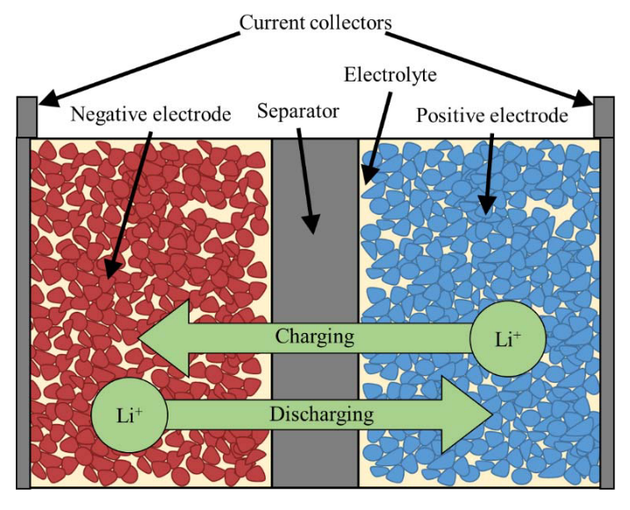
2. Basics of the Lithium-Ion Battery
Battery Cell Charge/Discharge Dynamics
The major components of Battery Cell
Positive Electrode
Negative Electrode
Electrolyte
Separator
Current Collector
Battery Cell Components [1]
Charge: Lithium ions deintercalate from Neg. Electrode and intercalate into Pos. Electrode
Discharge: Lithium ions deintercalate from Pos. Electrode and intercalate into Neg. Electrode
[1] D. J. Docimo et al. “Analysis and control of charge and temperature imbalance within a lithium-ion battery pack, 2018
Notes:
Next is the basics of the lithium-ion battery
First , I’ll talk about the components of the battery cell.
As you can see on the Figure, there are five major components of Battery cell. Positive electrode, Negative electrode, electrolyte, Separator and current collector.
Base on this composition I’ll explain the battery cell charge and discharge dynamics.
During the battery charge, the lithium-ions deintercalate from positive electrode’s particles and move through the electrolyte and then intercalate to the negative electrode’s particles. During this process, separator prevents electrons from flowing directly through electrodes and the current is produced depending on the electrons go through the external circuit. From this consequences, the voltage difference is occurred between the electrodes. Also, the opposite occurs during discharge. This can be modeled as a spherical diffusion process which I will explain afterwards.

Slide 5
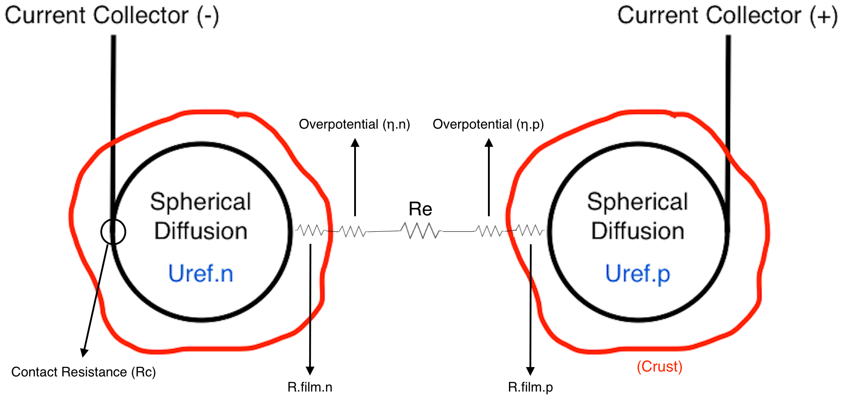
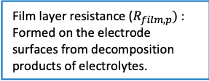
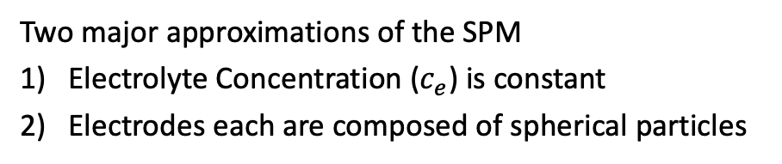
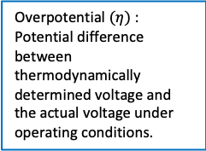
3. The Lithium-Ion Battery Model
Single Particle Model (SPM)
Single Particle Model is a common type of reduced order model which is a simplification of the 1D formulation for a lithium-ion battery
Two major approximations of the SPM
Electrolyte Concentration ($c_{e}$) is constant
Electrodes each are composed of spherical particles
Overpotential $(η)$ :
Potential difference between thermodynamically determined voltage and the actual voltage under operating conditions.
Film layer resistance ($R_{film,p})$ : Formed on the electrode surfaces from decomposition products of electrolytes.
Single Particle Model of Lithium-Ion Battery
Notes:
The third part of the presentation is the lithium ion battery model.
In my research, I used the single particle model on the lithium ion battery.
Single Particle model is a common type of reduced order model which is a simplification of 1D formulation for a lithium ion battery along with few assumptions.
First, it assumes that the electrolyte dynamics is neglectable. Which means that the electrolyte concentration is a constant value. Second, it idealizes each electrode as a single spherical particle.
You can see the composition of the single particle model in Figure. which has two spherical model of negative electrode and positive electrode.
While the battery cycles charge and discharge, the film layer formed on the electrode surfaces from decomposition products of electrolyte and this crust acts as a resistance.
And the overpotential is exist between the electrodes which is the potential difference between thermodynamically determined voltage and the actual voltage under operating conditions.
So, in the single particle model, these components must be considered to determine the output Voltage from the input currents.

Slide 6
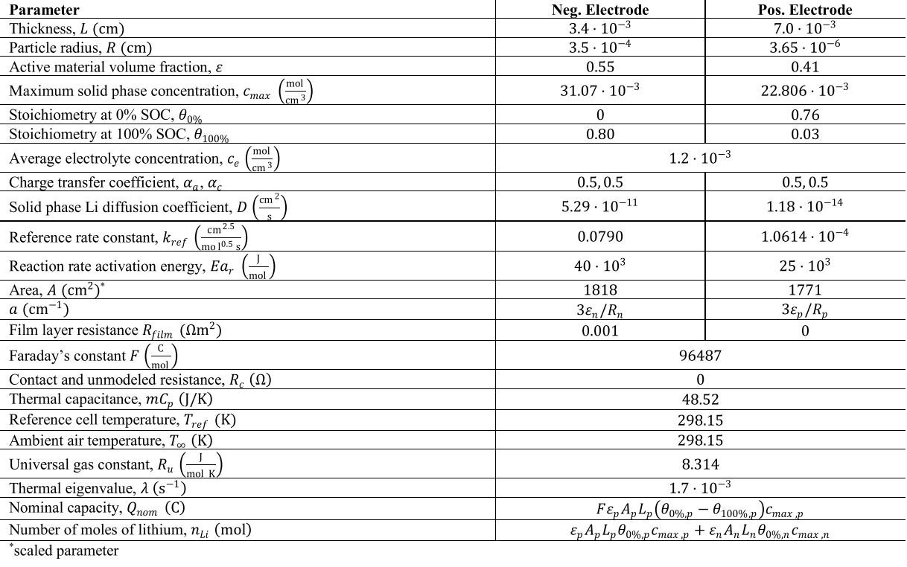

3. The Lithium-Ion Battery Model
Single Particle Model (SPM) $(Cont.)$
Battery Cell Parameter [2]
[2] D. J. Docimo et al. “Using a Linear Quadratic Regulator to Attenuate Cell-to-Cell Heterogeneity within a Lithium-Ion Battery Pack,” 2018
Notes:
This table is the battery cell parameter which I used on my research. These parameters have been used to get the surface concentrations and output Voltage.

Slide 7
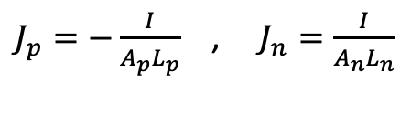
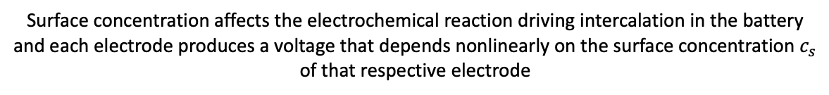
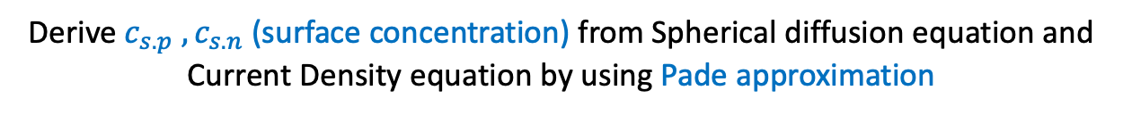
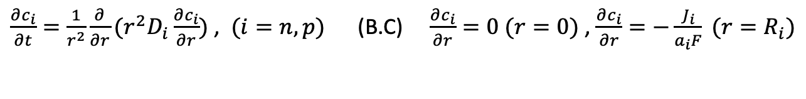
3. The Lithium-Ion Battery Model
Single Particle Model (SPM) $(Cont.)$
Spherical diffusion equation
$\frac{∂c_{i}}{∂t}=\frac{1}{r^{2}}\frac{∂}{∂r}(r^{2}D_{i}\frac{∂c_{i}}{∂r})$ , $(i=n,p)$ (B.C) $\frac{∂c_{i}}{∂r}=0 (r=0)$ , $\frac{∂c_{i}}{∂r}=−\frac{J_{i}}{a_{i}F} (r=R_{i})$
Current Density
$J_{p}=−\frac{I}{A_{p}L_{p}}$ , $J_{n}=\frac{I}{A_{n}L_{n}}$
(the positive current represents discharge in this notation)
Derive $c_{s.p} , c_{s.n}$ (surface concentration) from Spherical diffusion equation and Current Density equation by using Pade approximation
Surface concentration affects the electrochemical reaction driving intercalation in the battery and each electrode produces a voltage that depends nonlinearly on the surface concentration $c_{s}$ of that respective electrode
Notes:
In the previous slides, one of the assumptions in the single-particle model was each electrode is composed of a spherical particle.
For the case of a spherical particle, the intercalation of lithium ions in the solid phase is modeled as a process due to diffusion.
So, base on the Spherical diffusion equation and Current density we could derive the surface concentration by using pade approximation of the model reduction method. I’ll explain it in detail in further slides.
So, the reason why we need to figure out the surface concentration is the Surface concentration affects the electrochemical reaction driving intercalation in the battery and each electrode produces a voltage that depends nonlinearly on the surface concentration of that respective electrode.

Slide 8
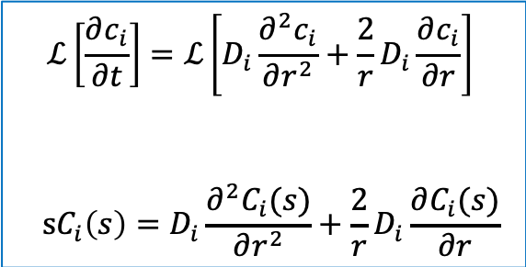

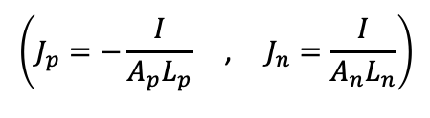
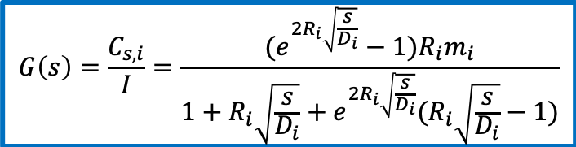
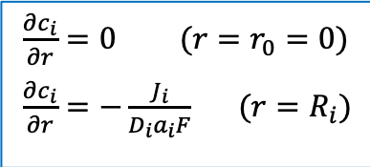
3. The Lithium-Ion Battery Model
Single Particle Model (SPM) $(Cont.)$
Compute Transfer functions between the input and output
Laplace Spherical Diffusion Equation
$$ℒ\left[\frac{∂c_{i}}{∂t}\right]=ℒ\left[D_{i}\frac{∂^{2}c_{i}}{∂r^{2}}+\frac{2}{r}D_{i}\frac{∂c_{i}}{∂r}\right]$$
$$sC_{i}\left(s\right)=D_{i}\frac{∂^{2}C_{i}(s)}{∂r^{2}}+\frac{2}{r}D_{i}\frac{∂C_{i}(s)}{∂r}$$
Infinite-dimensional Transfer function of the real model
$$G\left(s\right)=\frac{C_{s,i}}{I}=\frac{(e^{2R_{i}\sqrt{\frac{s}{D_{i}}}}−1)R_{i}m_{i}}{1+R_{i}\sqrt{\frac{s}{D_{i}}}+e^{2R_{i}\sqrt{\frac{s}{D_{i}}}}(R_{i}\sqrt{\frac{s}{D_{i}}}−1)}$$
↓
$$\left(J_{p}=−\frac{I}{A_{p}L_{p}}\text{ , }J_{n}=\frac{I}{A_{n}L_{n}}\right)$$
Apply Boundary Condition
$\frac{∂c_{i}}{∂r}=0 (r=r_{0}=0)$
$\frac{∂c_{i}}{∂r}=−\frac{J_{i}}{D_{i}a_{i}F} (r=R_{i})$
$$\left(m_{n}=\frac{1}{A_{n}L_{n}a_{n}D_{n}F} ,m_{p}=−\frac{1}{A_{p}L_{p}a_{p}D_{p}F}\right)$$
Notes:
To figure out the surface concentration we need to compute the transfer function between the input and output.
First, on the left side of the slides, we need to do a Laplace transform on spherical diffusion equation and apply the boundary conditions to get the transfer function.
After that, if you see the right side of the slides, I figured out the final solution of the transfer function of the real battery model on the single-particle model.
However, the transfer function is an infinite-dimensional transfer function that contains the exponential function.
So, we need to approximate this real model by doing the model reduction method.

Slide 9

3. The Lithium-Ion Battery Model
$\text{Model} \text{Reduction}\text{:}$ Pade approximation
Model Reduction?
Model Reduction is a method to simplify or approximate the real models to mathematical models
It gives better consideration of the physical systems, reduced computational complexity, reduced hardware complexity, simplified controller design and cost-effective solutions. [3]
Pade approximation
Pade approximation is the method of model reduction of the higher order system.
This gives the simplification of a model after converting it into a reduced order model. [4]
In the battery models, the Pade approximation is used for the transfer function $G\left(s\right)$ of spherical diffusion which is infinite-dimensional (includes exponential function).
[3] K. Ramawat et al. 2015
[4] S. Janardhanan 2013
Notes:
Model reduction is a method to simplify or approximate the real models to mathematical models. It gives better considerate of the physical systems, reduced computational complexity, reduced hardware complexity, simplified controller design and cost-effective solutions.
Among the various of the model reduction method, I choose to use the pade approximation method.
It is the method of the model reduction of the higher order system. This gives the simplification of a model after converting it into a reduced order model.
In the battery models, the $Pad\acute{e}$ approximation is used for the transfer function $G\left(s\right)$ of spherical diffusion which is infinite-dimensional.

Slide 10
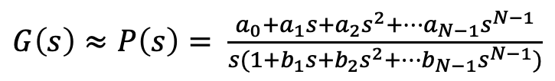
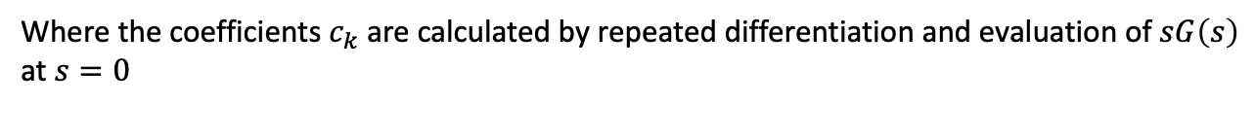
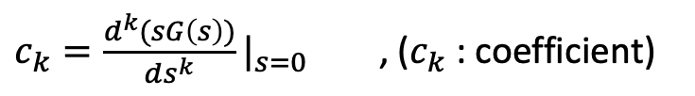
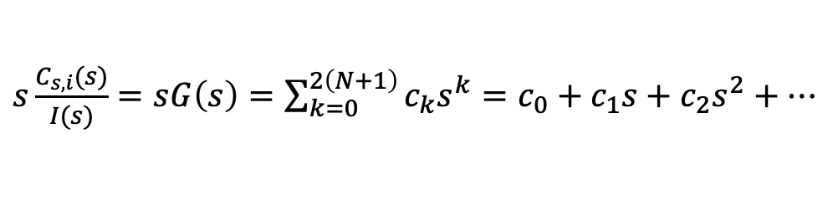
3. The Lithium-Ion Battery Model
Pade approximation
Power Series
Assume that the transfer function can be expanded in a power series
$s\frac{C_{s,i}(s)}{I(s)}=sG\left(s\right)=\sum_{k=0}^{2\left(N+1\right)}{c_{k}s^{k}}=c_{0}+c_{1}s+c_{2}s^{2}+…$
Pade approximation (P(s) for G(s))
$G\left(s\right)≈P\left(s\right)= \frac{a_{0}+a_{1}s+a_{2}s^{2}+…a_{N−1}s^{N−1}}{s(1+b_{1}s+b_{2}s^{2}+…b_{N−1}s^{N−1})}$
Where the coefficients $c_{k}$ are calculated by repeated differentiation and evaluation of $sG\left(s\right)$ at $s=0$
$c_{k}=\frac{d^{k}(sG\left(s\right))}{ds^{k}}|_{s=0}$ , ($c_{k}$ : coefficient)
Notes:
From this slide, I’ll explain briefly how to get the surface concentration using pade approximation in the transfer function.
First, we assume that the transfer function can be expanded in a power series.
Also, assume that the pade approximation form is nearly equal to transfer function of real model. Where the coefficients ck of the power series are calculated by repeated differentiation and evaluation of sG(s) at s=0.
I’ll explain with an example in the next slide.

Slide 11




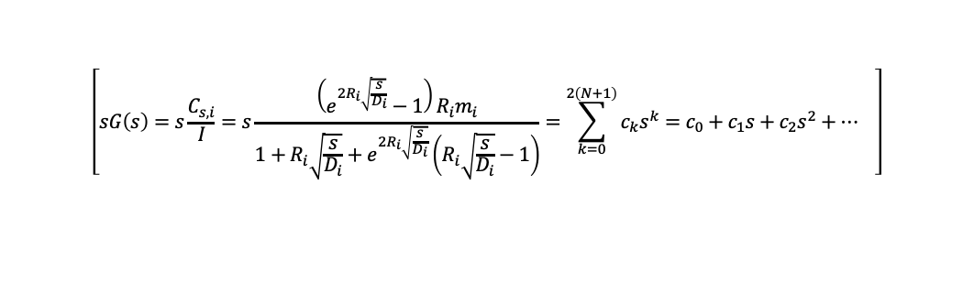
3. The Lithium-Ion Battery Model
Pade approximation $(Cont.)$
Example (2nd –order Pade approximation in Negative Electrode)
$$G\left(s\right)≈P\left(s\right)=\frac{a_{0}+a_{1}s}{s(1+b_{1}s)}$$
$$\left[sG\left(s\right)=s\frac{C_{s,i}}{I}=s\frac{\left(e^{2R_{i}\sqrt{\frac{s}{D_{i}}}}−1\right)R_{i}m_{i}}{1+R_{i}\sqrt{\frac{s}{D_{i}}}+e^{2R_{i}\sqrt{\frac{s}{D_{i}}}}\left(R_{i}\sqrt{\frac{s}{D_{i}}}−1\right)}=\sum_{k=0}^{2\left(N+1\right)}{c_{k}s^{k}}=c_{0}+c_{1}s+c_{2}s^{2}+… \right]$$
To figure out the Pade approximation coefficient ($a_{0}, a_{1}, b_{1}…)$
$sG\left(s\right)|_{s=0}=sP\left(s\right)|_{s=0}$ → $−\frac{3D_{n}m_{n}}{R_{n}}=a_{0}$
$\frac{d(sG\left(s\right))}{ds}|_{s=0}=$ $\frac{d(sP\left(s\right))}{ds}|_{s=0}$ → $−\frac{2m_{n}R_{n}}{7}=$ $a_{1}−a_{0}b_{1}$
$\frac{d^{2}(sG\left(s\right))}{ds^{2}}|_{s=0}=$ $\frac{d^{2}(sP\left(s\right))}{ds^{2}}|_{s=0}$ → $−\frac{2m_{n}R_{n}}{7}=$ ${{2b}_{1}(−a}_{1}+a_{0}b_{1})$
Notes:
This is the example in 2nd order pade approximation in negative electrode. As I explained in the previous slide, we can figure out the pade approximation coefficient by repeated differentiation and evaluation of transfer function. After getting the coefficient of the power series from each of the differentiation, we could get each of the coefficients of the pade approximation by using simultaneous equation.

Slide 12
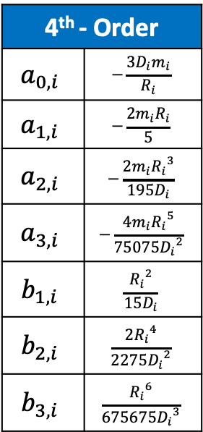
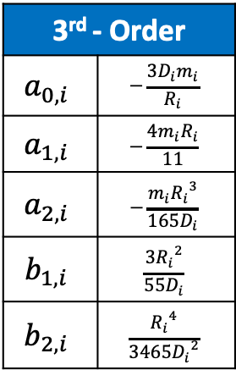
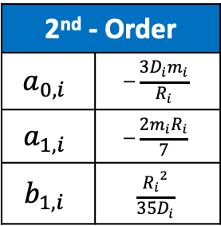
3. The Lithium-Ion Battery Model
Pade approximation $(Cont.)$
2nd , 3rd , 4th – Order Pade approximation coefficient at each electrode ($i=n,p)$ [5]
4th - Order
$$a_{0,i}$$ | $$−\frac{3D_{i}m_{i}}{R_{i}}$$
$$a_{1,i}$$ | $$−\frac{2m_{i}R_{i}}{5}$$
$$a_{2,i}$$ | $$−\frac{{{2m_{i}R}_{i}}^{3}}{195D_{i}}$$
$$a_{3,i}$$ | $$−\frac{{{{4m}_{i}R}_{i}}^{5}}{75075{D_{i}}^{2}}$$
$$b_{1,i}$$ | $$\frac{{R_{i}}^{2}}{15D_{i}}$$
$$b_{2,i}$$ | $$\frac{2{R_{i}}^{4}}{2275{D_{i}}^{2}}$$
$$b_{3,i}$$ | $$\frac{{R_{i}}^{6}}{675675{D_{i}}^{3}}$$
3rd - Order
$$a_{0,i}$$ | $$−\frac{3D_{i}m_{i}}{R_{i}}$$
$$a_{1,i}$$ | $$−\frac{4m_{i}R_{i}}{11}$$
$$a_{2,i}$$ | $$−\frac{{{m_{i}R}_{i}}^{3}}{165D_{i}}$$
$$b_{1,i}$$ | $$\frac{3{R_{i}}^{2}}{55D_{i}}$$
$$b_{2,i}$$ | $$\frac{{R_{i}}^{4}}{3465{D_{i}}^{2}}$$
2nd - Order
$$a_{0,i}$$ | $$−\frac{3D_{i}m_{i}}{R_{i}}$$
$$a_{1,i}$$ | $$−\frac{2m_{i}R_{i}}{7}$$
$$b_{1,i}$$ | $$\frac{{R_{i}}^{2}}{35D_{i}}$$
[5] J. Forman et al. “Reduction of an electrochemistry-based li-ion battery model via quasi-linearization and Pade approximation,” 2011
Notes:
By doing a calculation process which I explained before, I implemented on 2nd 3rd 4th order of pade approximation, and this table is the result of the calculation at each electrode and each orders.

Slide 13
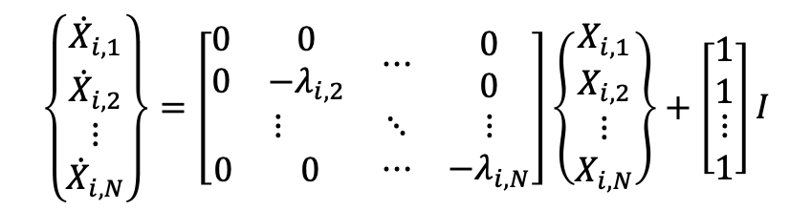
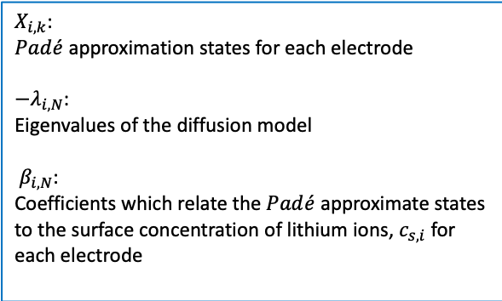
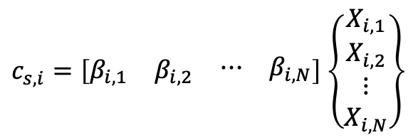
3. The Lithium-Ion Battery Model
Reduced Order Battery Model
Transfer function to State Space Model
→Predict the output response of battery systems to different inputs
$$\frac{C_{s,i}}{I}=\frac{a_{0}+a_{1}s+…a_{N−1}s^{N−1}}{s(1+b_{1}s+…b_{N−1}s^{N−1})}=\frac{a_{0}+a_{1}s+…a_{N−1}s^{N−1}}{s\left(s+λ_{i,2}\right)+…(s+λ_{i,N})}=\frac{β_{i,1}}{s}+\frac{β_{i,2}}{s+λ_{i,2}}+…\frac{β_{i,N}}{s+λ_{i,N}}$$
$$\left\{\begin{matrix}{\dot{X}}_{i,1} \\ {\dot{X}}_{i,2} \\ \begin{aligned}⋮ \\ {\dot{X}}_{i,N}\end{aligned}\end{matrix}\right\}=\left[\begin{matrix}\begin{matrix}0 & 0 \\ 0 & −λ_{i,2}\end{matrix} & ⋯ & \begin{aligned}0 \\ 0\end{aligned} \\ ⋮ & ⋱ & ⋮ \\ \begin{matrix}0 & 0 \end{matrix} & ⋯ & −λ_{i,N}\end{matrix}\right]\left\{\begin{matrix}X_{i,1} \\ X_{i,2} \\ \begin{aligned}⋮ \\ X_{i,N}\end{aligned}\end{matrix}\right\}+\left[\begin{matrix}1 \\ 1 \\ \begin{aligned}⋮ \\ 1\end{aligned}\end{matrix}\right]I$$
$X_{i,k}$:
$Pad\acute{e}$ approximation states for each electrode
${−λ}_{i,N}$:
Eigenvalues of the diffusion model
$β_{i,N}$:
Coefficients which relate the $Pad\acute{e}$ approximate states to the surface concentration of lithium ions, $c_{s,i}$ for each electrode
$c_{s,i}=\left[\begin{matrix}β_{i,1} & β_{i,2} & \begin{matrix}⋯ & β_{i,N}\end{matrix}\end{matrix}\right]$ $\left\{\begin{matrix}X_{i,1} \\ X_{i,2} \\ \begin{aligned}⋮ \\ X_{i,N}\end{aligned}\end{matrix}\right\}$
Notes:
From the pade approximation of the transfer function which I got before; I changed this function to state space model which predict the output response of the battery systems to different inputs.
From the state space model X is the pade approximation states for each electrode. lambda is the eigenvalues of the diffusion model.
And beta is the coefficients which relate the pade approximate states to the surface concentration of lithium ions for each electrodes.

Slide 14


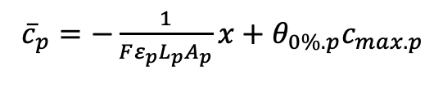
3. The Lithium-Ion Battery Model
Reduced Order Battery Model $(Cont.)$
Average concentration
${\overline{c}}_{i}=β_{i,1}X_{i,1}$
Output of the the surface concentration equation
$$c_{s,i}={\overline{c}}_{i}+β_{i,2}X_{i,2}+…+β_{i,N}X_{i,N}$$
Within the battery, lithium is conserved.
The total number of moles of lithium $n_{Li}$ can be related to the concentrations of the electrodes.
→ Easily calculated using the electrode stoichiometries of a healthy cell at 0% SOC (Assume $Q_{loss}=0)$
$n_{Li}=ε_{p}L_{p}A_{p}$ ${\overline{c}}_{p}$+ $ε_{n}L_{n}A_{n}$ ${\overline{c}}_{n}$ → ${\overline{c}}_{n}$= $\frac{1}{ε_{n}L_{n}A_{n}}(n_{Li}−ε_{p}L_{p}A_{p} {\overline{c}}_{p}$)
${\overline{c}}_{p}=−\frac{1}{Fε_{p}L_{p}A_{p}}x+θ_{0\%.p}c_{max.p}$
→ The average concentrations of lithium ions in the spherical particles which is related to a charge level (x) of the cell
Notes:
The average concentration in the electrode is defined by the first equation and this is the first states of the output equation. So that the output of the surface concentration can be defined as second equation.
To compute the average concentration, we need to know about the total number of moles of lithium. Within the battery, lithium is conserved. This can be related to the concentration of the electrodes which is easily calculated using the electrode stoichiometries of a healthy cell at 0% SOC.
So, we can get negative average concentration from the total number of moles of lithium.
And this I the positive average concentration equation which is related to the charge level of the cell.

Slide 15


3. The Lithium-Ion Battery Model
Reduced Order Battery Model $(Cont.)$
Charge level (x)
$\dot{x}=−I$ (dynamic equation for x)
→ Defines the state equation for the charge level of the battery, which makes $X_{i.1}$ redundant
Initial charge relating to initial concentration ${\overline{c}}_{p}$(0)
$$\left[{\overline{c}}_{p}=−\frac{1}{Fε_{p}L_{p}A_{p}}x+θ_{0\%,p}c_{max,p}\right]$$
(For a healthy cell ($Q_{loss}=0$), x=0 for a cell at 0% SOC and x= $Q_{nom}$ for a cell at 100% SOC)
$Q_{nom}=$ $Fε_{p}L_{p}A_{p}(θ_{0\%,p}−θ_{100\%,p})c_{max,p}$
In the experiment, assumed that SOC=0.5 → x(0)=0.5$Q_{nom}$
Notes:
The charge level is defined as xdot=-I for the first states of the equation. In my research, I set the initial condition as SOC equal to 0.5. SOC is the level of charge of the battery relative to its capacity which defined as $Q_{nom}=$ $Fε_{p}L_{p}A_{p}(θ_{0\%,p}−θ_{100\%,p})c_{max,p}$in this equatioin.

Slide 16

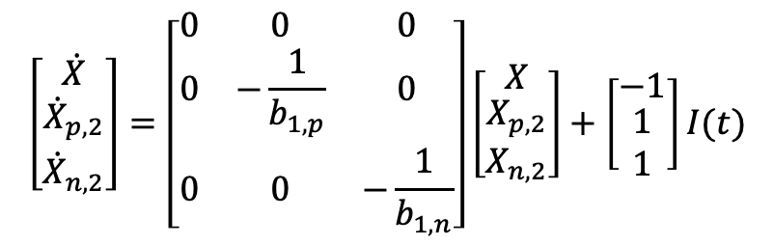

3. The Lithium-Ion Battery Model
Reduced Order Battery Model $(Cont.)$
The Spherical diffusion $Pad\acute{e}$ approximation State Space Model
Ex) 2nd –Order
Combined State space model of electrodes (in 2nd –Order)
$$\left[\begin{matrix}\dot{X} \\ \begin{aligned}{\dot{X}}_{p,2} \\ {\dot{X}}_{n,2}\end{aligned}\end{matrix}\right]=\left[\begin{matrix}0 & 0 & 0 \\ 0 & −\frac{1}{b_{1,p}} & 0 \\ 0 & 0 & −\frac{1}{b_{1,n}}\end{matrix}\right]\left[\begin{matrix}X \\ \begin{aligned}X_{p,2} \\ X_{n,2}\end{aligned}\end{matrix}\right]+\left[\begin{matrix}−1 \\ \begin{aligned}1 \\ 1\end{aligned}\end{matrix}\right]I(t)$$
(Charge level)
$$c_{s,n}={\overline{c}}_{n}+β_{n,2}X_{n,2}$$
$$c_{s,p}={\overline{c}}_{p}+β_{p,2}X_{p,2}$$
Notes:
As I explained previous slide, the first state is charge level which is same as each electrode, so I combined state space model of the negative and positive electrode. This is the final combined state space model of electrodes in 2nd order pade approximation. I expressed this state space model as first order ordinary differential equations in the MATLAB code.

Slide 17
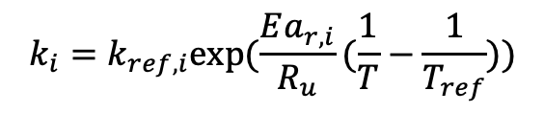
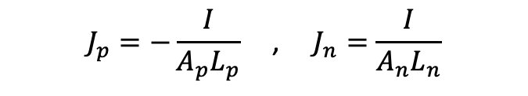
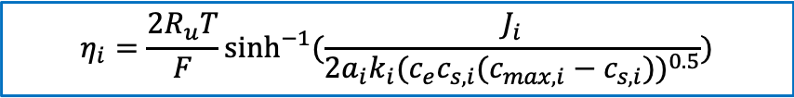
3. The Lithium-Ion Battery Model
Reduced Order Battery Model $(Cont.)$
Overpotential $(η)$
The reduced model of overpotential can be calculated by combining
Butler Volmer equation & Current Density
$$J_{i}=a_{i}k_{i}{{(c}_{e})}^{α_{a,i}}{\left(c_{max,i}−c_{s,i}\right)}^{α_{a,i}}{{(c}_{s,i})}^{α_{c,i}}(\exp\left(\frac{α_{a,i}F}{R_{u}T}η_{i}\right)−\exp\left(−\frac{α_{c,i}F}{R_{u}T}η_{i}\right))$$
$$k_{i}=k_{ref,i}exp⁡(\frac{Ea_{r,i}}{R_{u}}(\frac{1}{T}−\frac{1}{T_{ref}}))$$
$$J_{p}=−\frac{I}{A_{p}L_{p}}\text{ , }J_{n}=\frac{I}{A_{n}L_{n}}$$
$$η_{i}=\frac{2R_{u}T}{F}\sinh^{−1}{(\frac{J_{i}}{2a_{i}k_{i}{(c_{e}c_{s,i}(c_{max,i}−c_{s,i}))}^{0.5}})}$$
Notes:
This is the reduced model of overpotential. This can be calculated by combining Butler volmer equation and current density equation. From the reduced model of overpotential, we can figure out that the overpotential is a direct function of the input current and surface concentration.

Slide 18
3. The Lithium-Ion Battery Model
Reduced Order Battery Model $(Cont.)$
Output Voltage $(V)$
Finally, the reduced model of Output Voltage can be defined as
$V=U_{ref,p}(c_{s,p})$- $U_{ref,n}\left(c_{s,n}\right)+η_{p}−η_{p}−\left(\left(\frac{R_{film,p}}{A_{p}L_{p}a_{p}}\right)+\left(\frac{R_{film,p}}{A_{p}L_{p}a_{p}}\right)+R_{c}\right)I$
computed with
state space model
Calculated with reduced order model of overpotential
given
→The reference potentials $U_{ref,i}$ are functions of the surface concentrations.
Notes:
This is the final equation of the output voltage.
Let’s remind the single particle model figure. I discussed that we need to consider these components to determine the output voltage.
I could complete the output voltage equation from variables which I got through the model reduction.
In the first term of the equation, reference potentials are functions of the surface concentrations and this can be computed with the state space model which I got before. Also, in the second term the overpotential is calculated with reduced order model equation. And additional resistance parts can be calculated with given parameter.

Slide 19
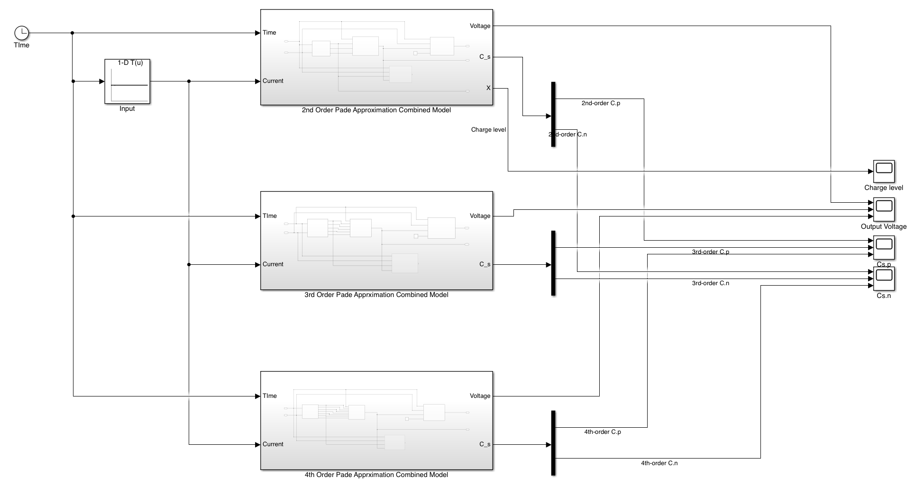
3. The Lithium-Ion Battery Model
Matlab & Simulink
Simulink Block diagram of the Battery Model
Notes:
This is the Simulink block diagram of the battery model. I extracted the plot of the charge level, surface concentration and output Voltage.

Slide 20
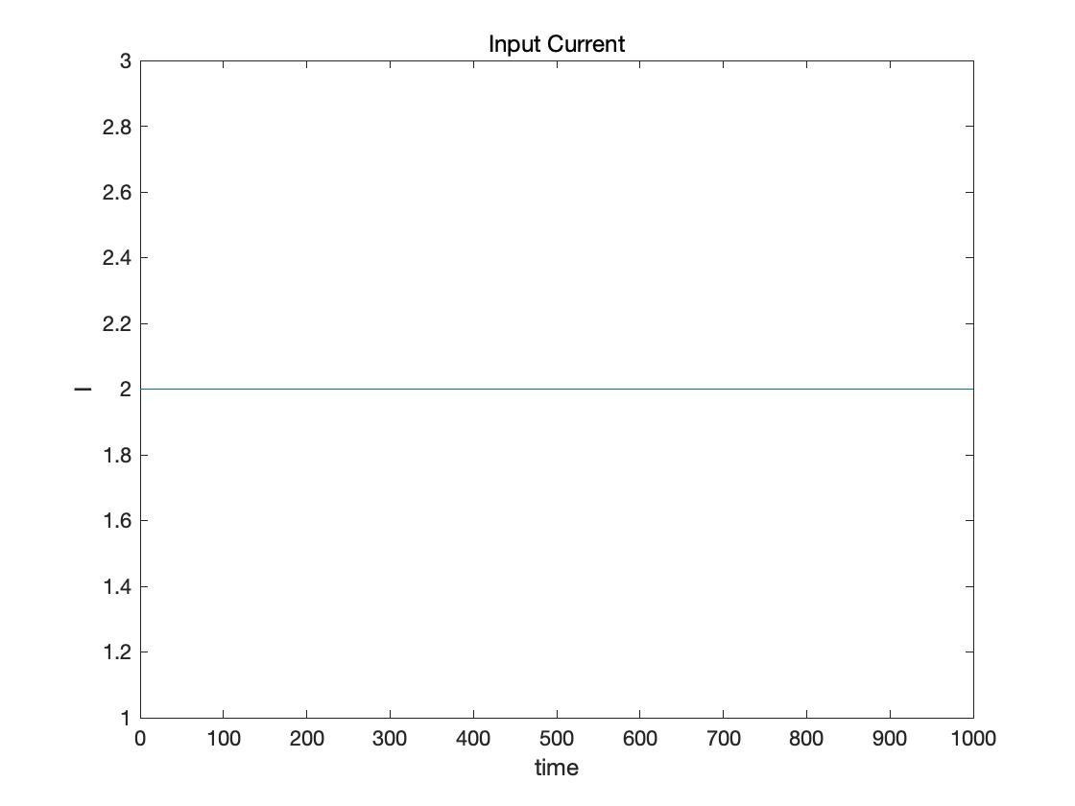
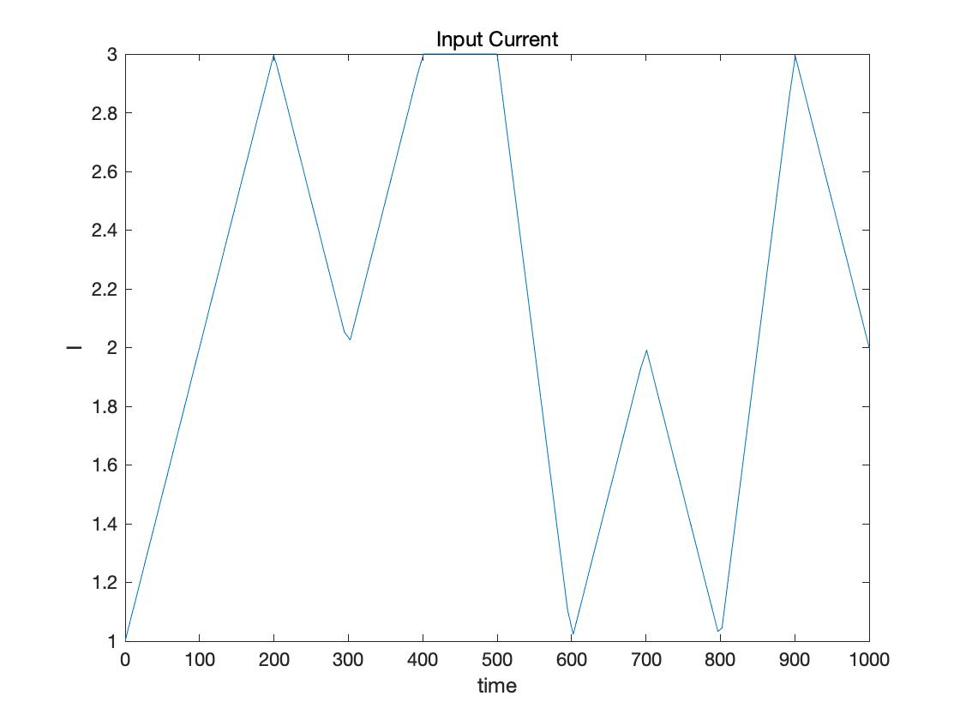
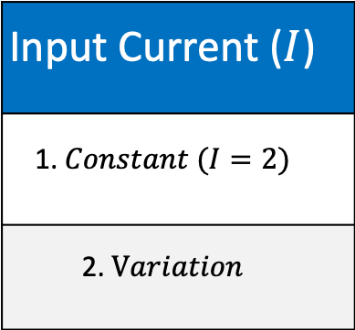
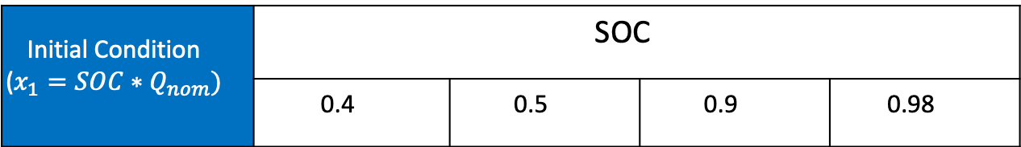
4. Results
Experimental Condition
Input Current ($I$)
1. $Constant (I=2)$
2. $Variation$
Initial Condition ($x_{1}=SOC∗Q_{nom})$ | SOC
1. $Constant (I=2)$ | 0.4 | 0.5 | 0.9 | 0.98
Notes:
Before moving on to the results part, I’ll explain the experimental condition.
I implemented the input current in two cases. First is constant input value and second is a variable input.
And I set the initial condtion SOC in 4 cases. I’ll show you the results at SOC=0.5.

Slide 21
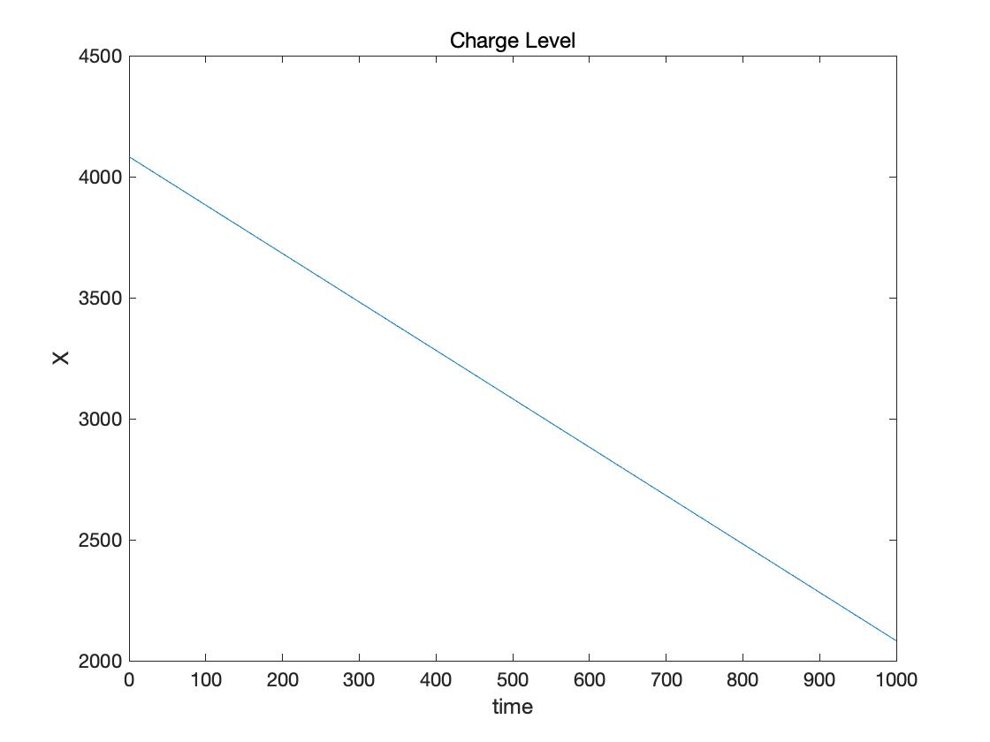

4. Results
Input = Constant($I=2$) & SOC=0.5
Current & Charge level
Current VS Time
Charge level VS Time
Notes:
First, I’ll show you the results at constant value of the input at SOC=0.5.
At the beginning of the presentation, I discussed that my research is focus on the discharge condition. So, if you look at a plot on the right side, you can see that the charge level is decreasing with time.

Slide 22
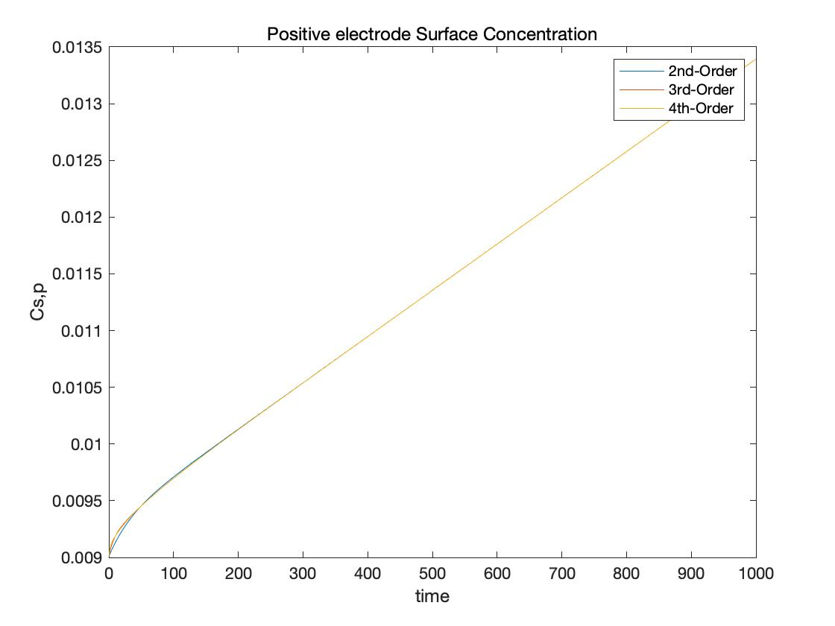
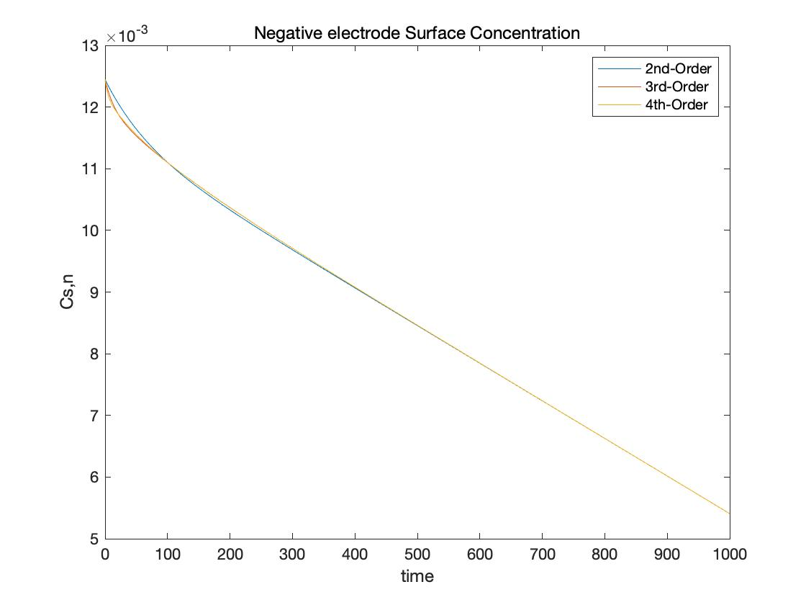


4. Results
Input = Constant , SOC=0.5
Surface Concentration
$c_{s,p}$ VS Time
$c_{s,n}$ VS Time
Notes:
And these plots are the surface concentration at each electrode with time. I explained that in discharge condition lithium-ions deintercalated from the negative electrode and intercalate to the positive electrode. That is why the positive surface concentration is increasing and negative surface concentration is decreasing in the plot

Slide 23
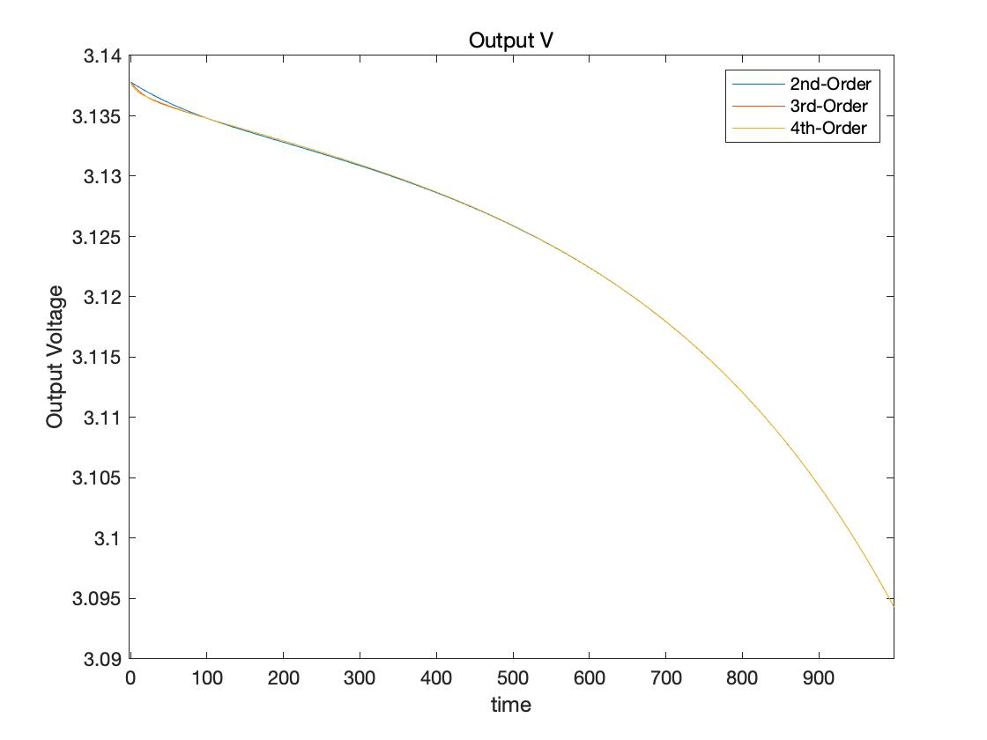
4. Results
Input = Constant , SOC=0.5
Output Voltage
Output V VS Time
Notes:
This is the plot of output Voltage vs time at each orders of pade approximation.
I can figure out that the results are slightly different between the orders.
I’ll explain these part in the conclusions.

Slide 24
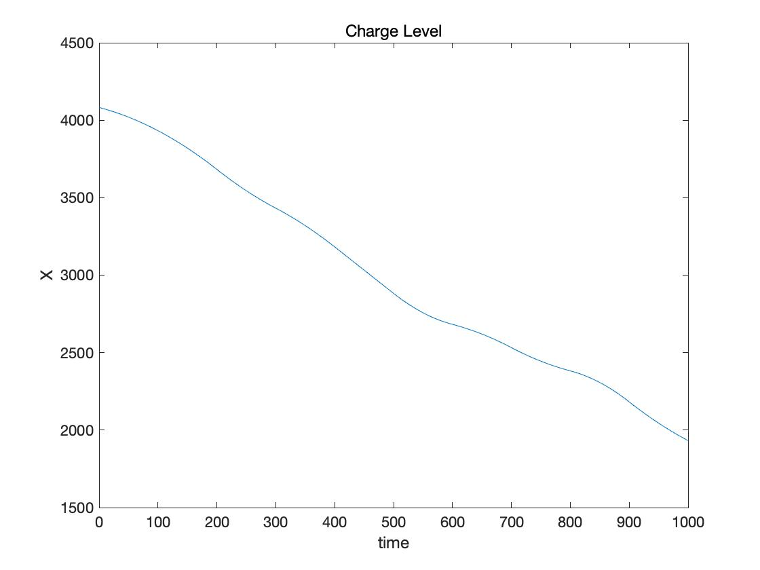
4. Results
Input = Variation & SOC=0.5
Current & Charge level
Current VS Time
Charge level VS Time
Notes:
Second is the results at variation value of the input at SOC=0.5.
The charge level also decreases over time because as I explained before, this is in a discharged condition.

Slide 25
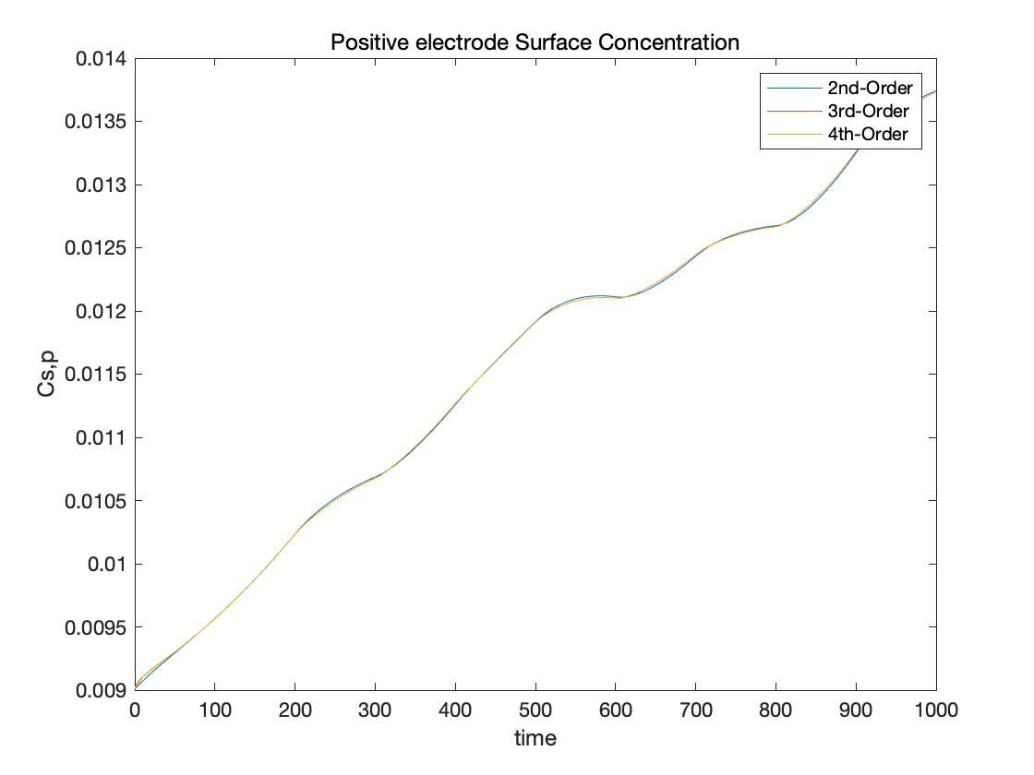
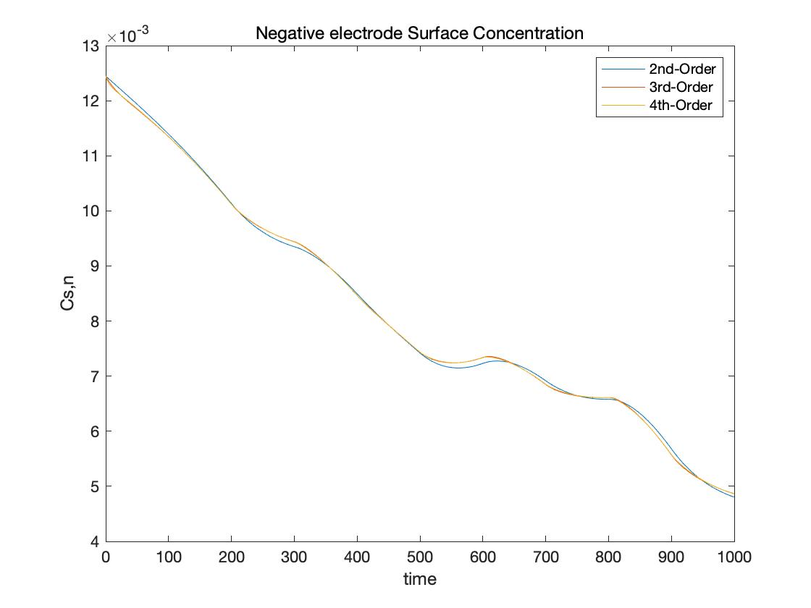
4. Results
Input = Variation & SOC=0.5
Surface Concentration
$c_{s,p}$ VS Time
$c_{s,n}$ VS Time
Notes:
And these plots are the surface concentration at each electrode with time. These are a little bit fluctuate over time, but they also show the same trend as for constant input

Slide 26
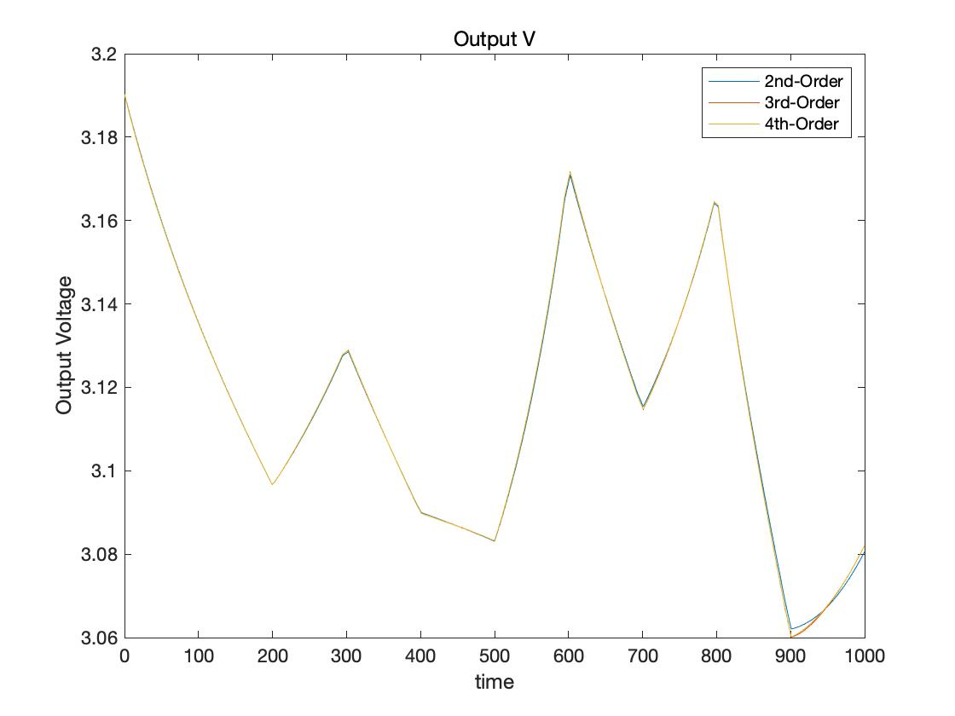
4. Results
Input = Variation & SOC=0.5
Output Voltage
Output V VS Time
Notes:
This is the plot of output Voltage vs time at each orders of pade approximation. As you can see from the plot, even though the voltage fluctuates over time, eventually we can figure out that the voltage is decreasing over time.

Slide 27
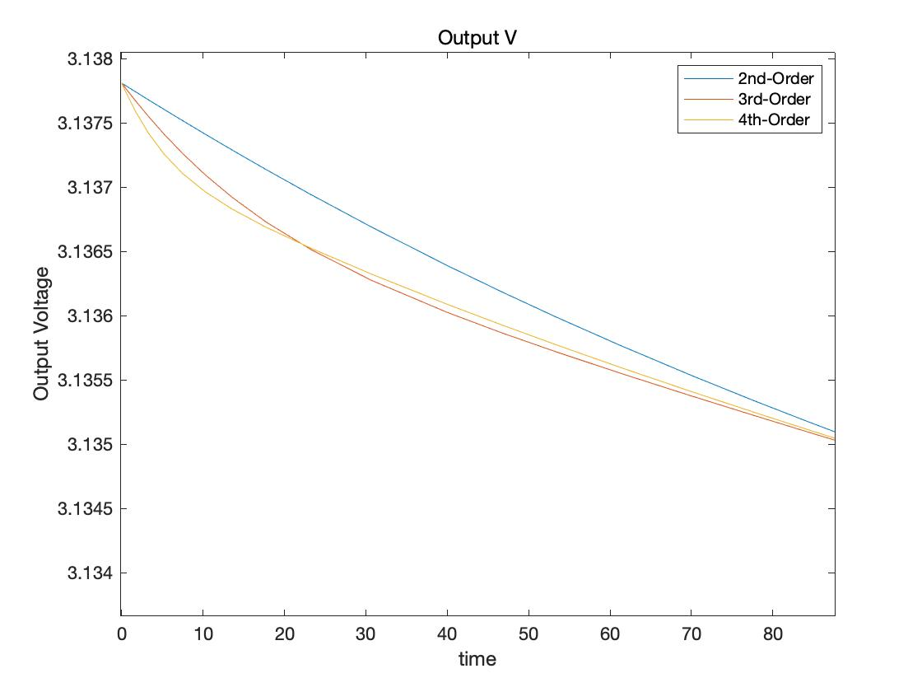
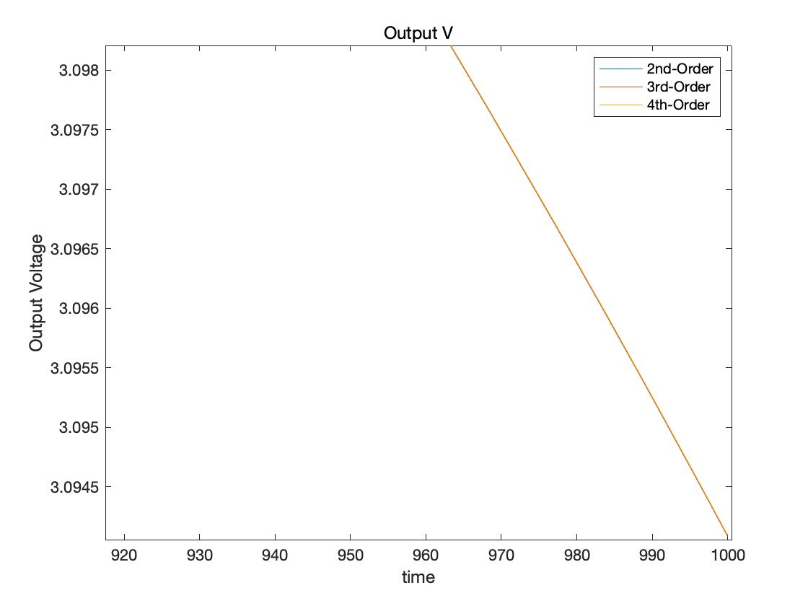

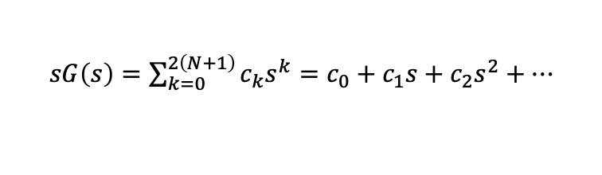
5. Conclusions
Accuracy
What is the most accurate result?
→ 4th – Order is the closest result to the real battery model
(Higher order → Higher accuracy)
Transient → Go to equilibrium
$sG\left(s\right)=\sum_{k=0}^{2\left(N+1\right)}{c_{k}s^{k}}=c_{0}+c_{1}s+c_{2}s^{2}+…$
$$c_{k}=\frac{d^{k}(sG\left(s\right))}{ds^{k}}|_{s=0}$$
Output V VS Time
Notes:
Now let’s move on to the conclusions part.
From the output Voltage plot, it can conclude that the results look similar. However, we can say that the voltage in the 4th -Order Pade approximation is the closest result to the real model.
When I expand the beginning of the plot, I can figure out that the results are slightly different between the orders. However, in the last part of the plot, we can figure out that all the orders are converged.
To explain this, we need to remind the pade approximation part. Transfer function expanded in a power series and substitute s=0 into the differential function. From this, the frequency is equal to zero so that the result eventually goes to the steady state. This is why the output voltage has a transient value at first but converges later.

Slide 28

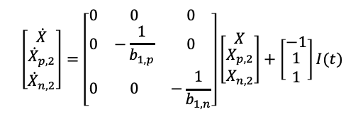

5. Conclusions
Basics of the Lithium-Ion Battery
Model Reduction: Pade approximation
$$G\left(s\right)≈P\left(s\right)=\frac{a_{0}+a_{1}s}{s(1+b_{1}s)}$$
$$\left[\begin{matrix}\dot{X} \\ \begin{aligned}{\dot{X}}_{p,2} \\ {\dot{X}}_{n,2}\end{aligned}\end{matrix}\right]=\left[\begin{matrix}0 & 0 & 0 \\ 0 & −\frac{1}{b_{1,p}} & 0 \\ 0 & 0 & −\frac{1}{b_{1,n}}\end{matrix}\right]\left[\begin{matrix}X \\ \begin{aligned}X_{p,2} \\ X_{n,2}\end{aligned}\end{matrix}\right]+\left[\begin{matrix}−1 \\ \begin{aligned}1 \\ 1\end{aligned}\end{matrix}\right]I(t)$$
$V=U_{ref,p}(c_{s,p})$- $U_{ref,n}\left(c_{s,n}\right)+η_{p}−η_{p}−\left(\left(\frac{R_{film,p}}{A_{p}L_{p}a_{p}}\right)+\left(\frac{R_{film,p}}{A_{p}L_{p}a_{p}}\right)+R_{c}\right)I$
Single Particle Model
Simulation Result
Notes:
Let me wrap up the main points of the presentation. I explained about the main components of the lithium-ion battery and charge and discharge dynamics. And then set the battery model as a single particle model.
After that I explained what is model reduction, pade approximation and how to do these method to figure out the output from the input which I settled. Lastly, I presented and analyzed the simulation results based on the experimental condition.

Slide 29
6. References
[1] ﻿D. J. Docimo and H. K. Fathy, “Analysis and control of charge and temperature imbalance within a lithium-ion battery pack,” IEEE Trans. Control Syst. Technol., 2018.
[2] ﻿ D. J. Docimo and H. K. Fathy, “Using a Linear Quadratic Regulator to Attenuate Cell-to-Cell Heterogeneity within a Lithium-Ion Battery Pack,” in IEEE Conference on Control Technology and Applications (CCTA), 2018, pp. 1935–1402.
[3] K. Ramawat, M. Bhandari, and A. Kumar, “Model Order Reduction by Pade Approximation and Improved Pole Clustering Technique”, Energy Technology & Ecological Concerns: A Contemporary Approach., 2015.
[4] J. Sivaramakrishnan, “Model Order Reduction and Controller Design Techniques”, 2005.
[5] ﻿J. C. Forman, S. Bashash, J. L. Stein, and H. K. Fathy, “Reduction of an electrochemistry-based li-ion battery model via quasi-linearization and Padé approximation,” J. Electrochem. Soc., vol. 158, no. 2, pp. A93–A101, 2011.
[6] D. J. Docimo, M. Ghanaatpishe, and H. K. Fathy, “Development and experimental parameterization of a physics-based second-order lithium-ion battery model” in Proc. ASME Dyn. Syst. Control Conf., 2014, p. V001T19A003.
[7] D. Zhang, S. Dey, and S. J. Moura, “Lithium-ion battery state estimation for a single particle model with intercalation-induced stress,” in Annual American Control Conference (ACC), pp. 2294–2299, IEEE, 2018.
[8] D. J. Docimo, “Insights into the Behavior of Heterogeneous Thermostatically Controlled Loads and Battery Packs.”, 2017.
Notes:
So, this is the end of the presentation and thanks for listening.

